Slide 1
SOC 102
Lecture 1
Introduction to Inequality
Professor Rachel La Touche

Slide 2
Who am I?
1
2
3
4
5
6
7
8
9
10
11
12
13
14
15
16
17
18
19
20
I have ____ pet(s)
I’ve visited _____ countries
I have owned ____ car(s) in my lifetime
I have spoken ____ language(s) in my lifetime
I have taught for _____ semester(s) at the university-level
I have ____ kid(s)
I have ____ sibling(s)

Slide 3
Who are they?
Andreea Mogosanu (Course Coordinator)
Responsible for all administrative manners
Registration
Grades
Accommodations
Scheduling
Blackboard etc.
Chang Lin (Lead TA)
Responsible for TA Support and Tutorials
Tutorial leadership
Test & Exam Prep
Kaitlyn Quinn (Course Mentor)
Responsible for Tutorials and MindTAP
Tutorial leadership
Test & Exam Prep
MindTAP participation

Slide 4
Outline
Epistemology Exercise
Syllabus, Course Breakdown, Blackboard (Portal), Readings etc.
Introduction to MindTAP
Lecture content:
What is inequality?

Slide 5
Epistemology
The study of the ____________________ (methods, validity and scope)
Who says what, where does the information come from, and should we believe them?

Slide 6
Epistemology: Exercise
Tell me something you believe very, very confidently (something that is 100% true)!
How do you know what you know?

Slide 7
There are many ways to know the social world
________________
________________
________________
________________
________________
________________
Not all ways of knowing are equally _________ and/or ___________
Some ways of knowing are especially privileged: e.g. ________________

Slide 8
Epistemology
This course will explore scientific knowledge, primarily in the ___________. But…
The __________ doesn’t negate the __________, and
The __________doesn’t negate the ___________
With any scientific knowledge, we should question its ____________ and __________

Slide 9
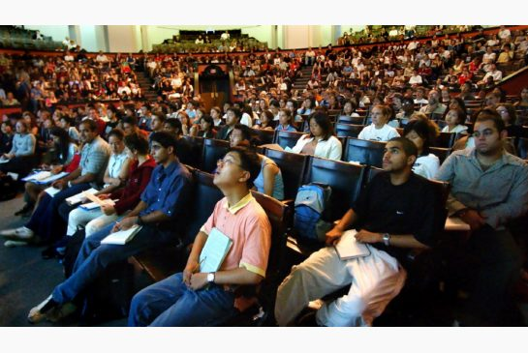
Getting started…
Always start with Portal:
The syllabus is posted here
Announcements will be posted here
TA contact information is posted here
Grades will be posted here
https://portal.utoronto.ca/webapps/portal/execute/tabs/tabAction?tab_tab_group_id=_12_1

Slide 10

Required Readings:
SOC102: Introduction to Sociology – Social Inequality
A collaborative course text with excerpts from classical texts (Marx, Weber, Durkheim) and contemporary scholars (Grabb, Brym, Brock etc.)
Available at the UofT Bookstore and Robarts Library (on reserve)

Slide 11
Readings + Lectures
Readings must be completed before class
The readings and lectures are designed to be complementary
In lecture, we will review central concepts AND expand on core ideas

Slide 12
Lectures
Outline slides will be posted Monday morning for students to print or use electronically during class
Slides will provide a roadmap for each class, including definitions, examples of central concepts, and discussion questions
Students are expected to add to the lecture slides with their own notes
Note: Only outline slides will be posted so ask someone to take notes for you if you’re going to miss class.
Note: Unless you provide documentation from the accessibility office, please do not record lectures without my consent.

Slide 13

Lectures
During lecture, we will clarify points of confusion about the readings, develop new perspectives about inequality and create links between authors
In addition, questions from the previous class about course content will be addressed during lecture (using the question box up front)

Slide 14
Tutorials
There are four (4) tutorials over the course of this semester. While they are optional, students are STRONGLY encouraged to attend.
January 16th (SOC102 success strategies)
January 30th (test prep)
March 6th (test prep)
March 12th (exam prep)
Note: All the information you require to sign up for tutorials is available on Blackboard.

Slide 15
Down to business…
Your grade is comprised of:
Test 1 25%
Test 2 25%
Final Exam (TBD) 30%
MindTap Participation (4) 20%
Important Due Dates:
TEST 1 Monday February 6th
TEST 2 Monday March 13th
MindTAP 1 Monday January 23rd @ 3pm
MindTAP 2 Monday February 13th @ 3pm
MindTAP 3 Monday February 27th @ 3pm
MindTAP 4 Monday March 27th @ 3pm

Slide 16
Tests
Test 1 and Test 2 are NOT cumulative (2 hours each)
The final exam IS cumulative (3 hours)
All tests and the exam are multiple choice and true/false
Locations and times will be announced when they become available

Slide 17
MindTAP
Katherine Baker-Ross – Nelson Education

Slide 18
MindTAP & Participation Exercises
MindTAP, on its own, is helpful for students wanting additional practice with core concepts and ideas in this course.
However, you will also be using MindTAP to complete 4 participation exercises throughout the course:
One week before each due date, a short participation exercise consisting of questions about the readings and lecture material will appear on MindTAP.
Each participation exercise is worth 5%
The dates when participation exercises will be posted are as follows: Monday January 16th, Monday February 6th, Monday February 20th and Monday March 20th. No late submissions will be allowed.
Note: Reminders and instructions for where to access the participation exercises will be sent via Blackboard!

Slide 19
Course Policies
Each of the following are detailed on the syllabus:
Accessibility
Late Assignments/Missed Tests
Writing Centres
Email Protocol
Academic Integrity

Slide 20
Who gets what, and why?!!
What can we learn from capuchin monkeys about social inequality in humans?
https://youtu.be/lKhAd0Tyny0
________________
________________
________________
________________

Slide 21
Who gets what, and why?!!
Difference ≠ Inequality
We are different in numerous ways (e.g. height, family size, food preference)
Differences don’t always manifest themselves as inequality

Slide 22
Difference ≠ Inequality
When we speak of________________, we are typically referring to ________________________________ (Weber)
I.e. different ________________because of unequal ________________
Sociologists are interested in:
How social inequalities come about (i.e. the _______________________________)
The ________________ of social inequalities (inequality → ______________)

Slide 23
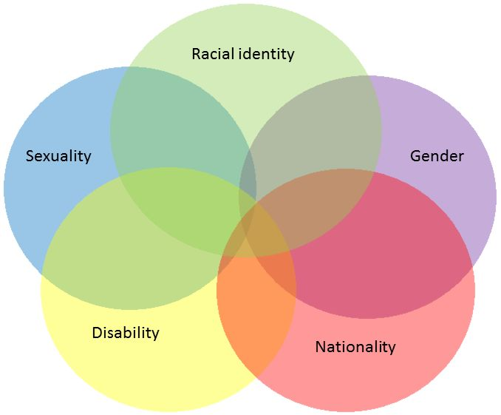
Life Chances are Intersectional
Disadvantages are ________________
The _______________ under which particular characteristics combine (e.g. gender and race), produce ________________

Slide 24

Intersectionality
Recognizes the ________________ and ________________ of systems of disadvantage creating unique life trajectories
“The whole is greater than the sum of its parts” – Aristotle
Life chances must be considered as part of a ________________, rather than as ________________

Slide 25
A framework for unique standpoints
Where you are and who you are in the world, shapes your ability to see others where they are and for who they are.
Intersectionality allows us to see experiences, attitudes and opinions as attached to the people that propose them (________________!)
In this course, we will critically examine our own ________________ (i.e. beliefs about ourselves and our experiences) and determine, in part, how this shapes our ________________________________

Slide 26
Ask yourself
When is inequality justifiable?
How much inequality is too much?
What’s more important: equality of opportunity of equality of outcome?

Slide 27
What people believe is interesting
Sociologists not only study ________________ social problems, but also people’s _____________ about these problems, and the _______________ thereof.
There is arguably some distance between ________________ and ________________.
What happens in the world may differ from the way people experience/perceive the real world (to a greater or lesser degree).

Slide 28
What you believe is important
Beyond interesting, what you believe about the world around you has important consequences for you.
Social inequality (perceived or otherwise) has important consequences for _____________,____________________,_______________

Slide 29
What you believe is contestable
E.g. If I have 25 people waiting outside my office at the beginning of office hours. I don’t know who came first because I don’t have a sign up sheet. I can only see 15 students in the time allotted. I let the students (you) decide how to solve the problem. What should you do?
First come, first serve?
Alphabetical order?
Pull numbers from a hat?
By the magnitude of help each student requires? (most to least)

Slide 30
What you believe is contestable
How you answer this question relates to:
Your ideas regarding ________________ (how privileges are ________________)
Your own ________________ (within broader society)
Your ________________ (previous experiences, or not, with this circumstance)

Slide 31
Overview
With a seemingly trivial question like this one, it is understandable that identifying, measuring and eradicating social inequality is quite a challenge.
In fact, we likely disagree on ________________________________ and whether it is worth ________________.
It doesn’t change the fact, however, that inequality is ________________!

Slide 32
Key Concepts
_______________- An idea about how part of the world works
_______________- An educated guess about how this theory plays out in real life
_______________- Associated with positivist epistemology, regarded as the collection and analysis of numerical data
_______________- Associated with interpretative epistemology, referring to forms of data collection and analysis that rely on understanding, with an emphasis on meanings

Slide 33
What now?…
Place any questions you have for me in the question box!
Sign-up for Tutorial 1 – Strategies for Success in SOC102 (January 16-20)
For next week…
Readings: Theories of Social Inequality: An Introduction
Coming up…
MindTAP Participation Exercise #1 will be available Monday January 16th and due Monday January 23rd!

